Slide 1
Stack Application
Towers of Hanoi

Slide 2
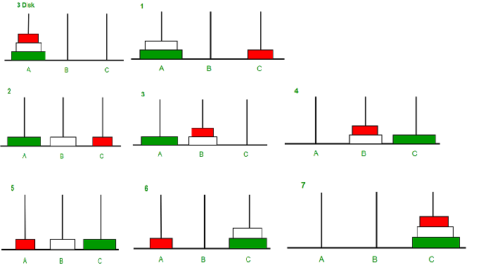

Slide 3
Tower of Hanoi is a mathematical puzzle where we have three pegs/rods and n disks.
The objective of the puzzle is to move the entire stack to another rod, obeying the following simple rules:
Only one disk can be moved at a time.
Each move consists of taking the upper disk from one of the stacks and placing it on top of another stack [i.e. a disk can only be moved if it is the uppermost disk on a stack.]
No disk may be placed on top of a smaller disk.

Slide 4
Program to Solve Tower-of-Hanoi Problem using Recursion

Slide 5
Tower of Hanoi Solution for n disks:
/* C program for Tower of Hanoi using Recursion */
#include <stdio.h>
void towers(int, char, char, char);
int main()
{ int num;
printf("Enter the number of disks : ");
scanf("%d", &num);
printf("The sequence of moves involved in the Tower of Hanoi are :\n");
towers(num, 'A', 'C', 'B');
return 0;
}
void towers(int num, char frompeg, char topeg, char auxpeg)
{ if (num == 1)
{ printf("\n Move disk 1 from peg %c to peg %c", frompeg, topeg);
return;
}
towers(num - 1, frompeg, auxpeg, topeg);
printf("\n Move disk %d from peg %c to peg %c", num, frompeg, topeg);
towers(num - 1, auxpeg, topeg, frompeg);
}

Slide 6
output
Enter the number of disks : 3
The sequence of moves involved in the Tower of Hanoi are :
Move disk 1 from peg A to peg C
Move disk 2 from peg A to peg B
Move disk 1 from peg C to peg B
Move disk 3 from peg A to peg C
Move disk 1 from peg B to peg A
Move disk 2 from peg B to peg C
Move disk 1 from peg A to peg C

Slide 7
ToH - With four disks
Move disk from rod A to rod C
A: [] B: [3, 2, 1] C: [4]
Move disk from rod B to rod C
A: [] B: [3, 2] C: [4, 1]
Move disk from rod B to rod A
A: [2] B: [3] C: [4, 1]
Move disk from rod C to rod A
A: [2, 1] B: [3] C: [4]
Move disk from rod B to rod C
A: [2, 1] B: [] C: [4, 3]
Move disk from rod A to rod B
A: [2] B: [1] C: [4, 3]
Move disk from rod A to rod C
A: [] B: [1] C: [4, 3, 2]
Move disk from rod B to rod C
A: [] B: [] C: [4, 3, 2, 1]
A: [4, 3, 2, 1] B: [] C: []
Move disk from rod A to rod B
A: [4, 3, 2] B: [1] C: []
Move disk from rod A to rod C
A: [4, 3] B: [1] C: [2]
Move disk from rod B to rod C
A: [4, 3] B: [] C: [2, 1]
Move disk from rod A to rod B
A: [4] B: [3] C: [2, 1]
Move disk from rod C to rod A
A: [4, 1] B: [3] C: [2]
Move disk from rod C to rod B
A: [4, 1] B: [3, 2] C: []
Move disk from rod A to rod B
A: [4] B: [3, 2, 1] C: []

